Slide 1
Healthcare Training (Basic)

Slide 2
Healthcare industry introduction-1
Healthcare
Pharma
Medical Device
Biotech
OTC
Device
Equipment

Slide 3
Job v.s. Title
New Drug R&D
Research
Clinical Research I/II/III
CRA
License
RA
BNHI Price
RA+PE
Listing
DM/KA
Purchasing
DM/KA
Prescription by Dr.
Sales

Slide 4
Drug / Company type
Drug Type
  Brand Name
  Me too
  Generic
Company Type
  MNC
  Distribution
  Local manufacture

Slide 5
MNC top 10
Pfizer (+Wyeth) 輝瑞(+惠氏)
MSD (+Schering Plough) 美商默沙東(+先靈葆雅)
Novartis 諾華
Sanofi-Aventis 賽諾菲安萬特
GSK 荷商葛蘭素史克藥廠
AstraZeneca 阿斯特捷利康
Bayer 拜耳
Abbott 亞培
Eli Lilly 禮來
Janssen-Clag 楊森
BMS 中美施贵宝

Slide 6
Department in hospital
一般內科 | General Medicine | GM/IM
家醫科 | Family Medicine
心臟科 | Cardiology | CV
胃腸肝膽科 | Gastroenterology | GI
胸腔科 | Chest
腎臟科 | Nephrology | Nephro
內分泌新陳代謝科 | Metabolism & Endocrinology | Meta
血液腫瘤科 | Hematology & Oncology | Hema & Onco
心臟血管外科 | Cardiovascular Surgery | CS
感染科 | Infection Disease | ID
風濕免疫科 | Rheumatology | RA

Slide 7
Department in hospital
神經科 | Neurology | Neuro
精神科 | Psychiatry
婦產科 | Obstetrics & Gynecology | Obs & Gyn
生殖內分泌科 | Reproductive Endocrinology & Infertility | Infertility
優生保健科 | Genetics
小兒外科 | Pediatric Surgery
小兒科 | Pediatrics | Ped
新生兒科 | Neonatology
小兒腸胃科 | Pediatric Gastroenterology
小兒心臟科 | Pediatric Cardiology

Slide 8
Department in hospital
一般外科 | General Surgery | GS
神經外科 | Neurosurgery | NS
整形外科 | Plastic Surgery | PS
皮膚科 | Dermatology | Derma
骨科 | Orthopedics | Ortho/Bone
胸腔外科 | Chest Surgery | CS
疼痛科 | Pain Management
耳鼻喉科 | Otolaryngology | ENT (ear, nose, throat)
眼科 | Ophthalmology | Ophtha
復健科 | Rehabilitation Medicine | Reha
泌尿科 | Urology | Uro

Slide 9
Top 10 Medicine
排行 | 名稱 | 藥廠 | 藥理分類 | 98年申報金額(億)
1 | Norvasc | Pfizer | 降血壓藥 | 45
2 | Lipitor | Pfizer | 降血脂藥 | 17
3 | Diovan | Novartis | 降血壓藥 | 16
4 | Recombinant | Bayer | 血友病用藥 | 16
5 | Plavix | SA | 血栓溶解劑 | 15
6 | Duetact | Takeda | 降血糖藥 | 14
7 | Gleevec | Novartis | 抗癌藥 | 12
8 | Crestor | AZ | 降血脂藥 | 12
9 | Actos | Takeda | 降血糖藥 | 11
10 | Cozaar | Merk | 降血壓藥 | 11

Slide 10
Medical Function

Slide 11
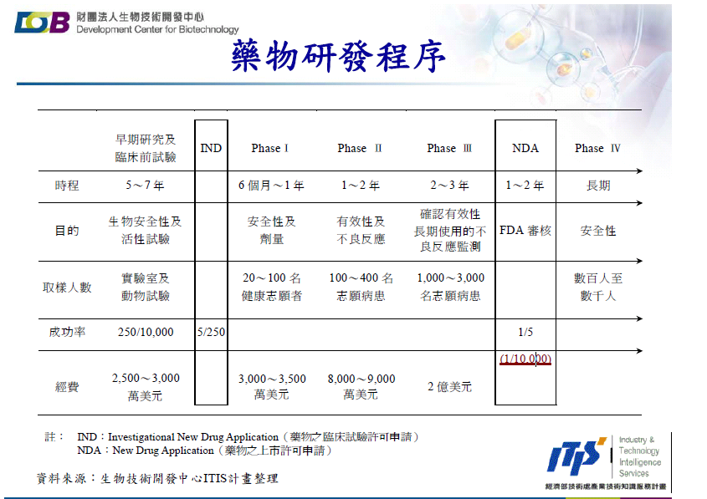

Slide 12
CRO
IND NDA
Preclinical → Clinical Trial →
Discovery
Marketing
Business Range of CRO (Contract Research Organization)
IND-investigational new drug
NDA-new drug application

Slide 13
Protocol Development
CRF/Informed Consent Form Development
Physician
Investigator/Site Selection
Regulatory Approval
IRB Approval
Investigator Meetings
Drug Management
Site Initiation
Patient Recruitment
Clinical Monitoring
Laboratory Data Review
Adverse Event Reporting
Biostatistics and Data Management
Clinical Report
Regulatory Submission

Slide 14
Protocol Development
CRF/Informed Consent Form Development
Pharma-CTA
CRO-SSU
Investigator/Site Selection
Regulatory Approval
IRB Approval
Investigator Meetings
Drug Management
Site Initiation
Patient Recruitment
Clinical Monitoring
Laboratory Data Review
Adverse Event Reporting
Biostatistics and Data Management
Clinical Report
Regulatory Submission

Slide 15
Protocol Development
CRA
CRF/Informed Consent Form Development
Investigator/Site Selection
Regulatory Approval
IRB Approval
Investigator Meetings
Drug Management
Site Initiation
Patient Recruitment
Clinical Monitoring
Laboratory Data Review
Adverse Event Reporting
Biostatistics and Data Management
Clinical Report
Regulatory Submission

Slide 16
Protocol Development
CRF/Informed Consent Form Development
Investigator/Site Selection
Regulatory Approval
IRB Approval
Investigator Meetings
Drug Management
Site Initiation
Patient Recruitment
Data Management
Clinical Monitoring
Laboratory Data Review
Adverse Event Reporting
Biostatistics and Data Management
Clinical Report
Regulatory Submission

Slide 17
